Slide 1

To Fly
Kenneth Lasseter
Justin Chacko
Theon Thomas
Christina Dulal

Slide 2
Museum Exhibit
The Museum of Discovery and Science’s To Fly exhibit displays various aircraft that chronicles the advancement of flight from our skies into space. Our app aims to help present this information to the museum patrons. By including additional information on the various aircraft in the museum we hope to better visitors’ experiences and have them leave the museum having learned something new.

Slide 3
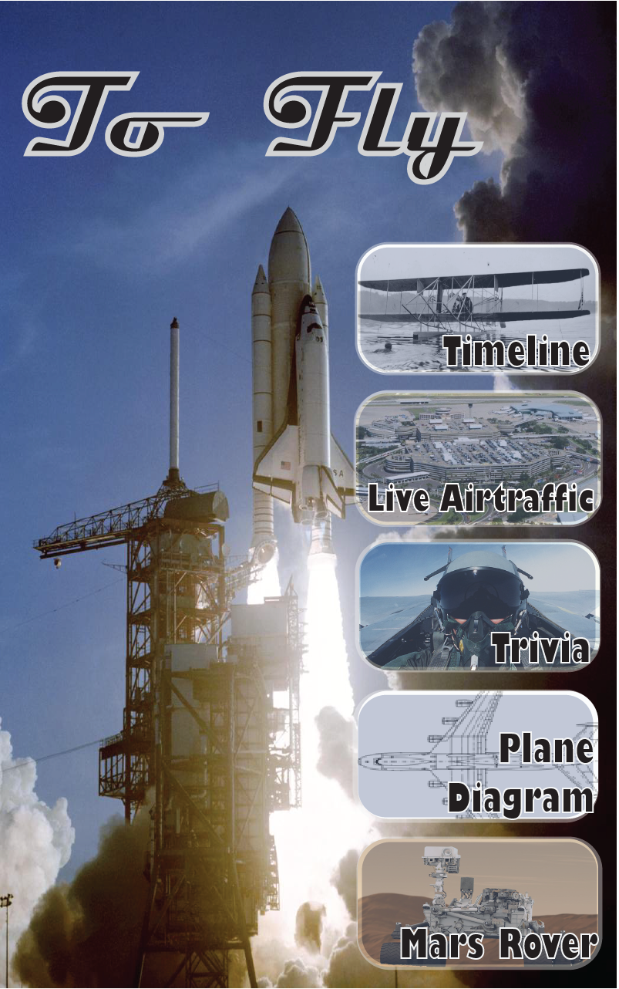
Main Screen
The main screen of our app works as our hub with all parts of our application being accessed through here. It follows the theme of our exhibit with flight and spaceflight being our main points of focus.

Slide 4
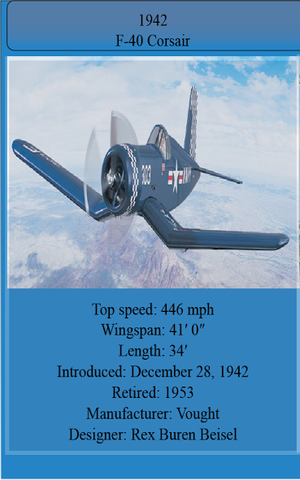
Timeline
Our timeline presents the planes within the To Fly exhibit in chronological order. It also gives extra information on each aircraft, such as the year of their introduction and manufacturer, which aircraft enthusiasts may enjoy.

Slide 5
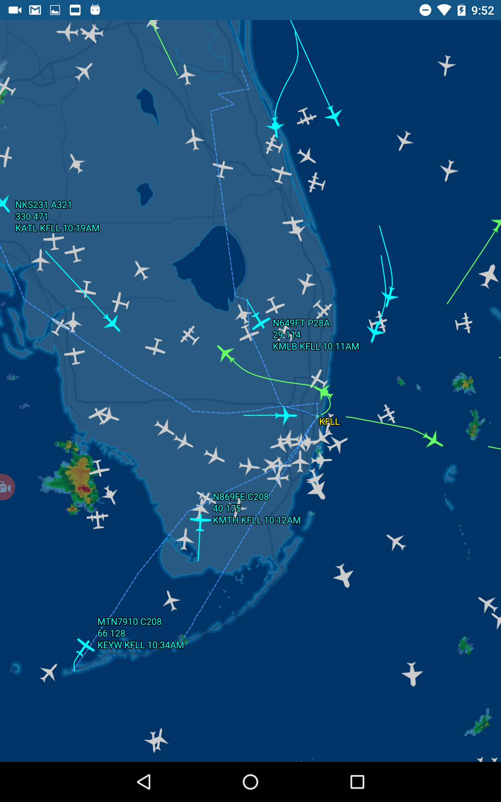
Air Traffic Control Map
The map included in our application is a live feed of the arrivals and departures of Fort Lauderdale-Hollywood International Airport.
Most people don’t realize how many flights come in and out of airports so the map will allow them to better visualize this fact.

Slide 6
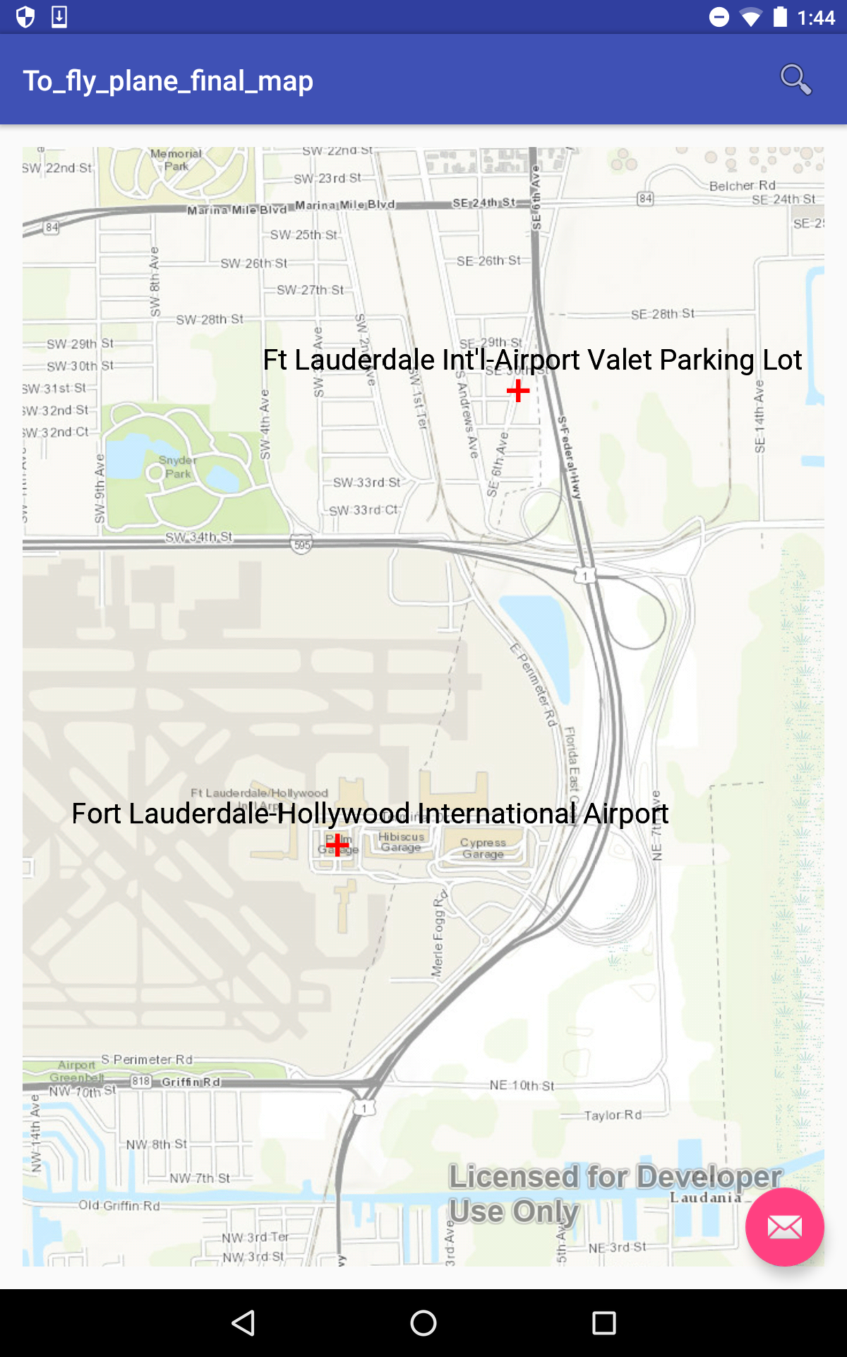
Airport locator
The airport locator serves as a tool which can be utilized to find airports and aviation related activities, fostering interest in aeronautics and aviation.

Slide 7
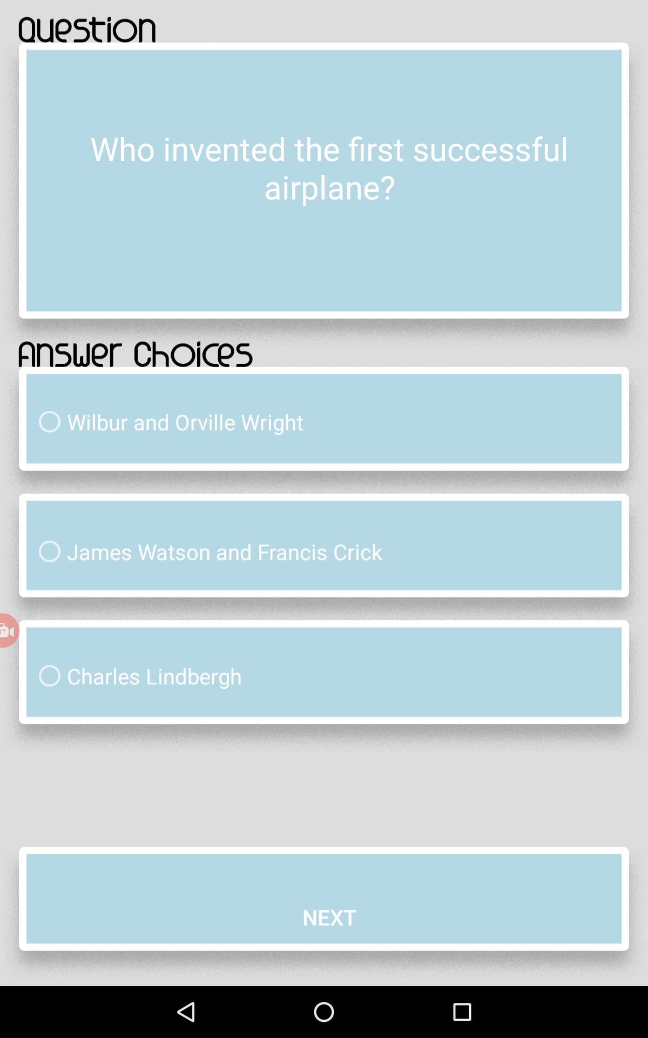
Trivia
We hope that by walking through the To Fly exhibit the museum patrons will learn something. The museum has plenty information scattered about the planes and parts that many patrons pass over. The trivia game in our application will challenge their knowledge and make sure they pay close attention to information in the exhibit.

Slide 8
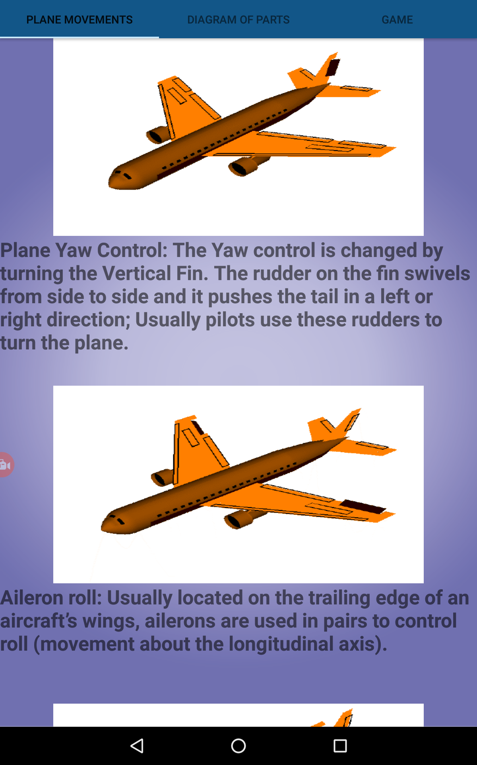
Plane parts
The To Fly exhibit has a number of displays that explain how the various parts in the plane work. Our app aims to give more in depth information about the parts of the airplane.
We’ve included animated gifs of parts, such as the Elevators and Ailerons, and how they affect the flight of the plane.

Slide 9
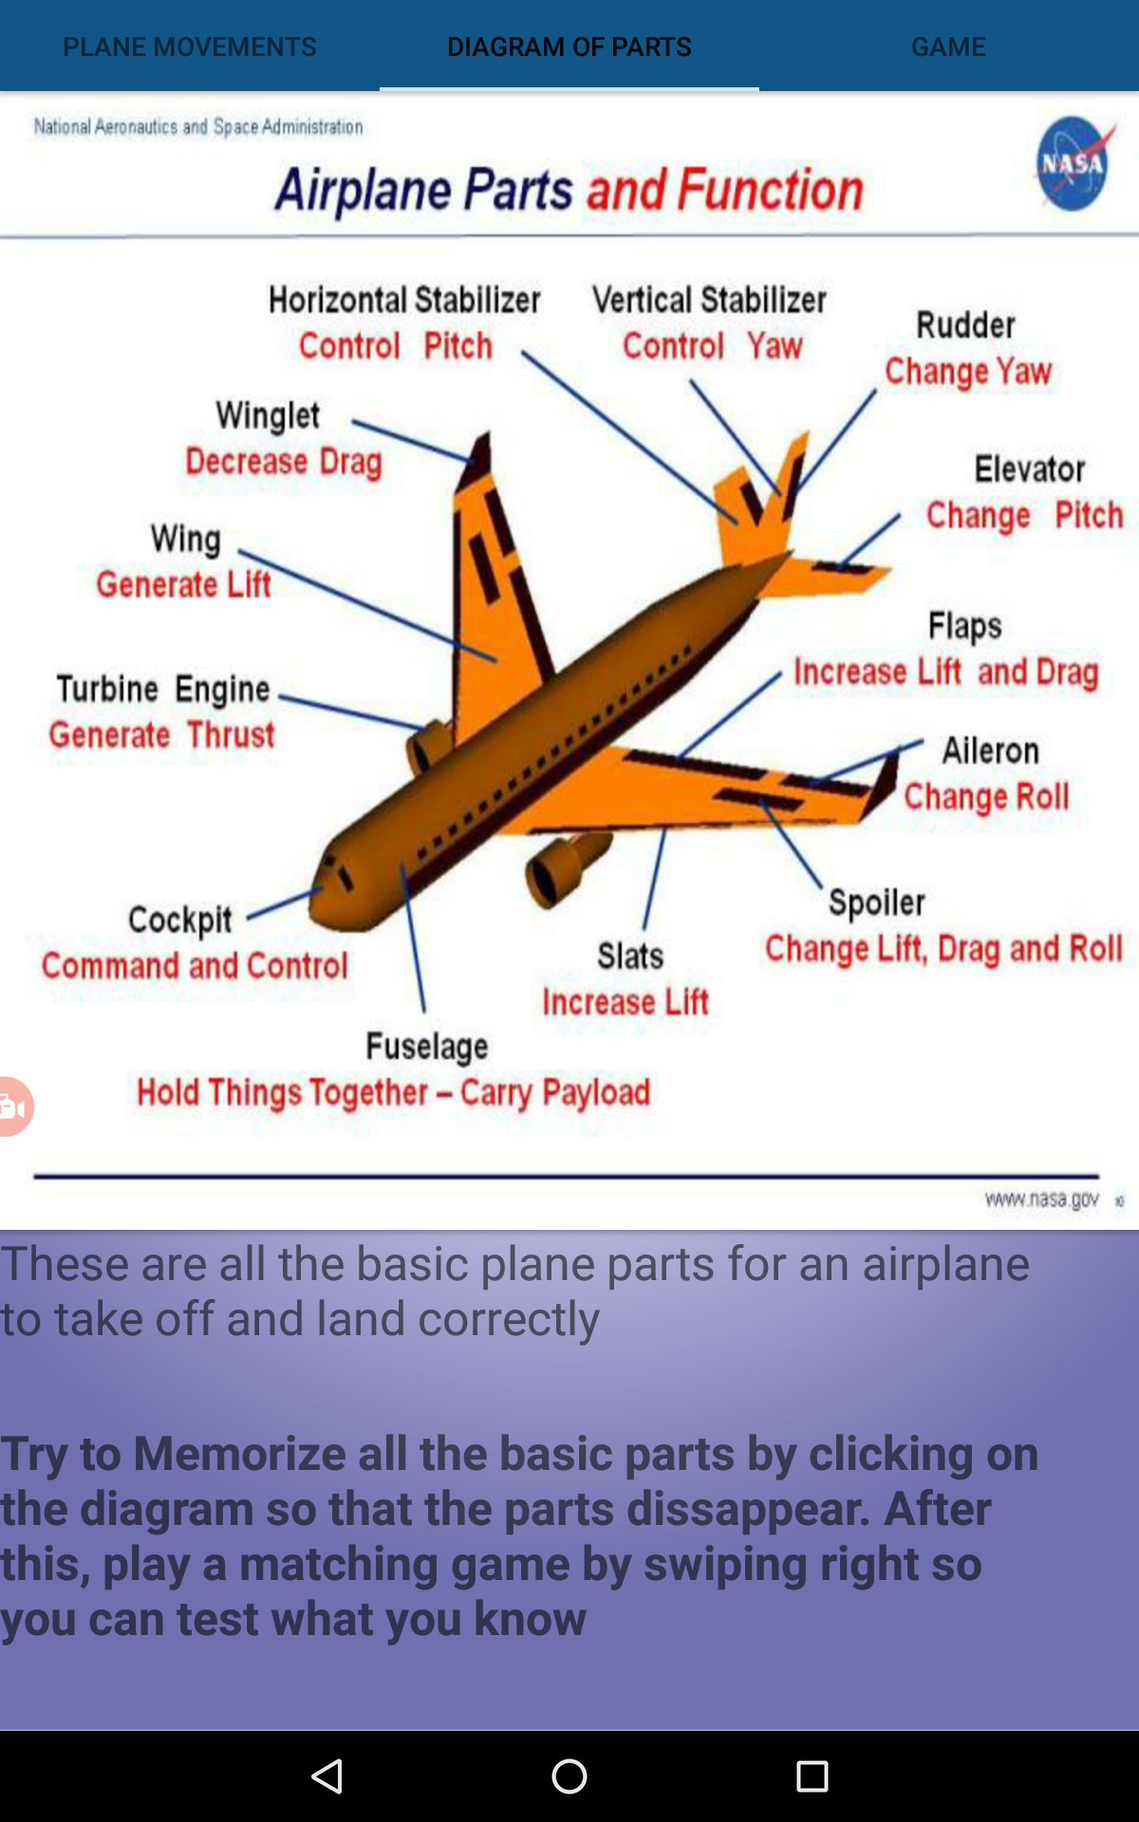
Plane Parts Game
In addition to the animated gifs, we’ve also included a small game.
In the game the player has to match the names with the parts or the plane. This makes sure that they retain the information given.

Slide 10
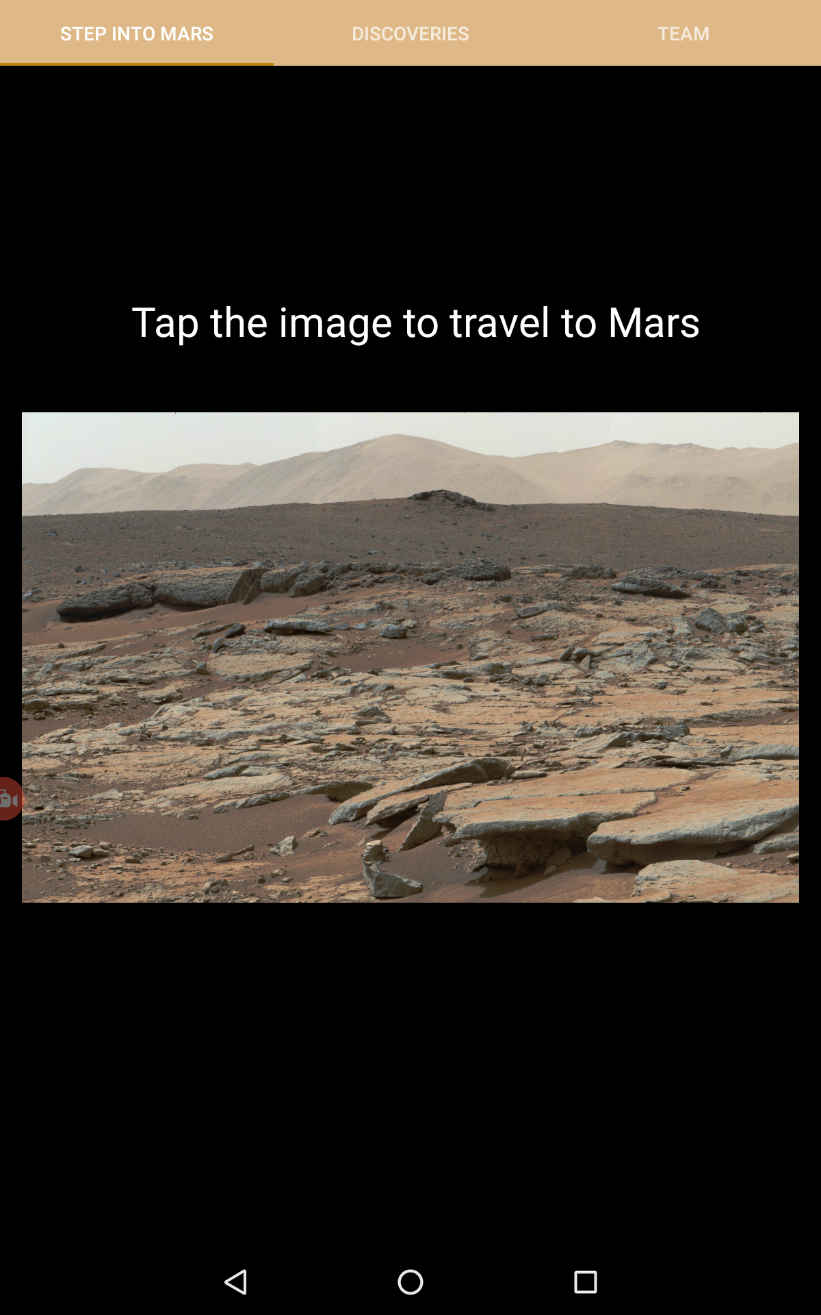
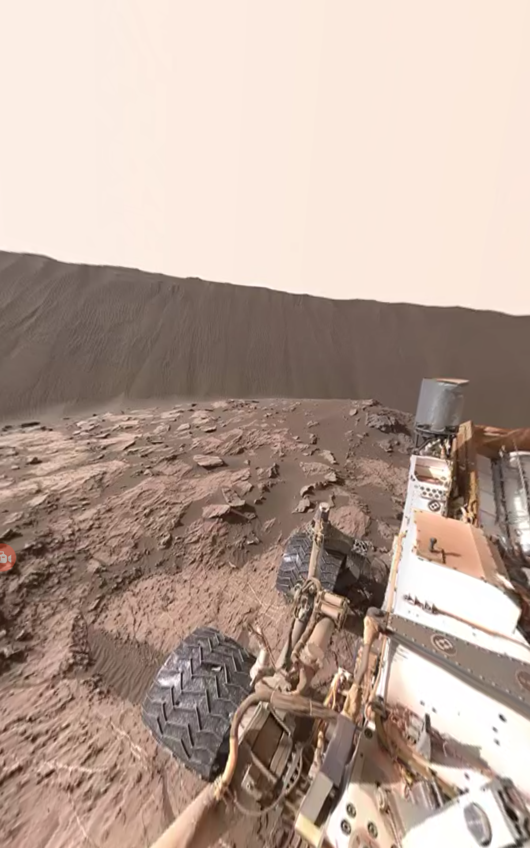
Mars rover
We have included a Mars VR experience in our app. Museum patrons can visit Mars through their smartphones without the need of a space shuttle.
Fully using the internal gyroscope of the smart device, museum patrons can move their phones around to view Mars from the eyes of a Mars Rover in 3D.

Slide 11
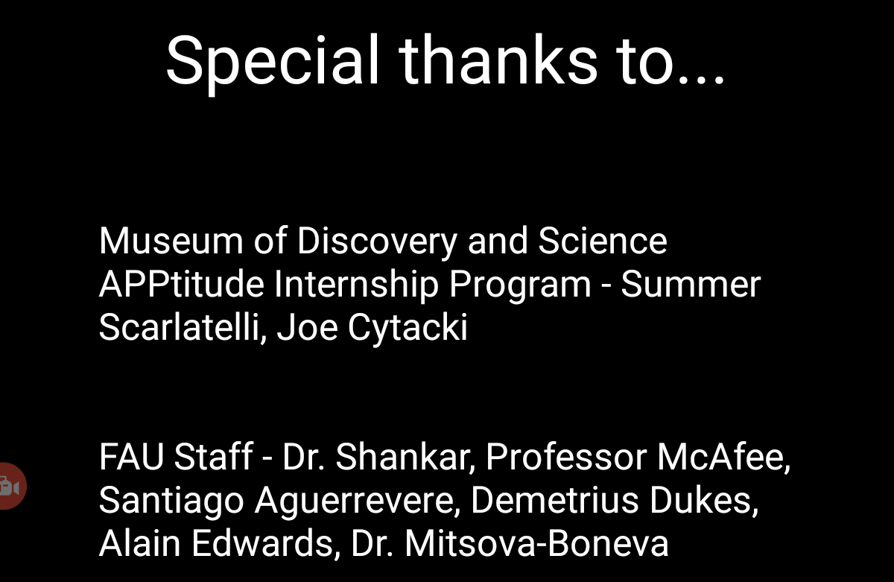
Credits
Our group could not have done this on our own. We thank those who helped us create this application and those that gave us the opportunity to work together.

